Slide 1
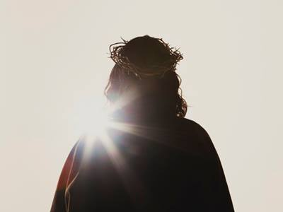
Be Knowledgeable
2 Peter
Dr. Rick Griffith • Crossroads International Church Singapore
BibleStudyDownloads.org

Slide 2
Key Word
284
Knowledge
2 Peter
Notes:
You probably will be happy to hear that the Bible has much to say about knowledge—that seeking knowledge is a great thing! That is the key word for the letter of 2 Peter that we will study today.

Slide 3
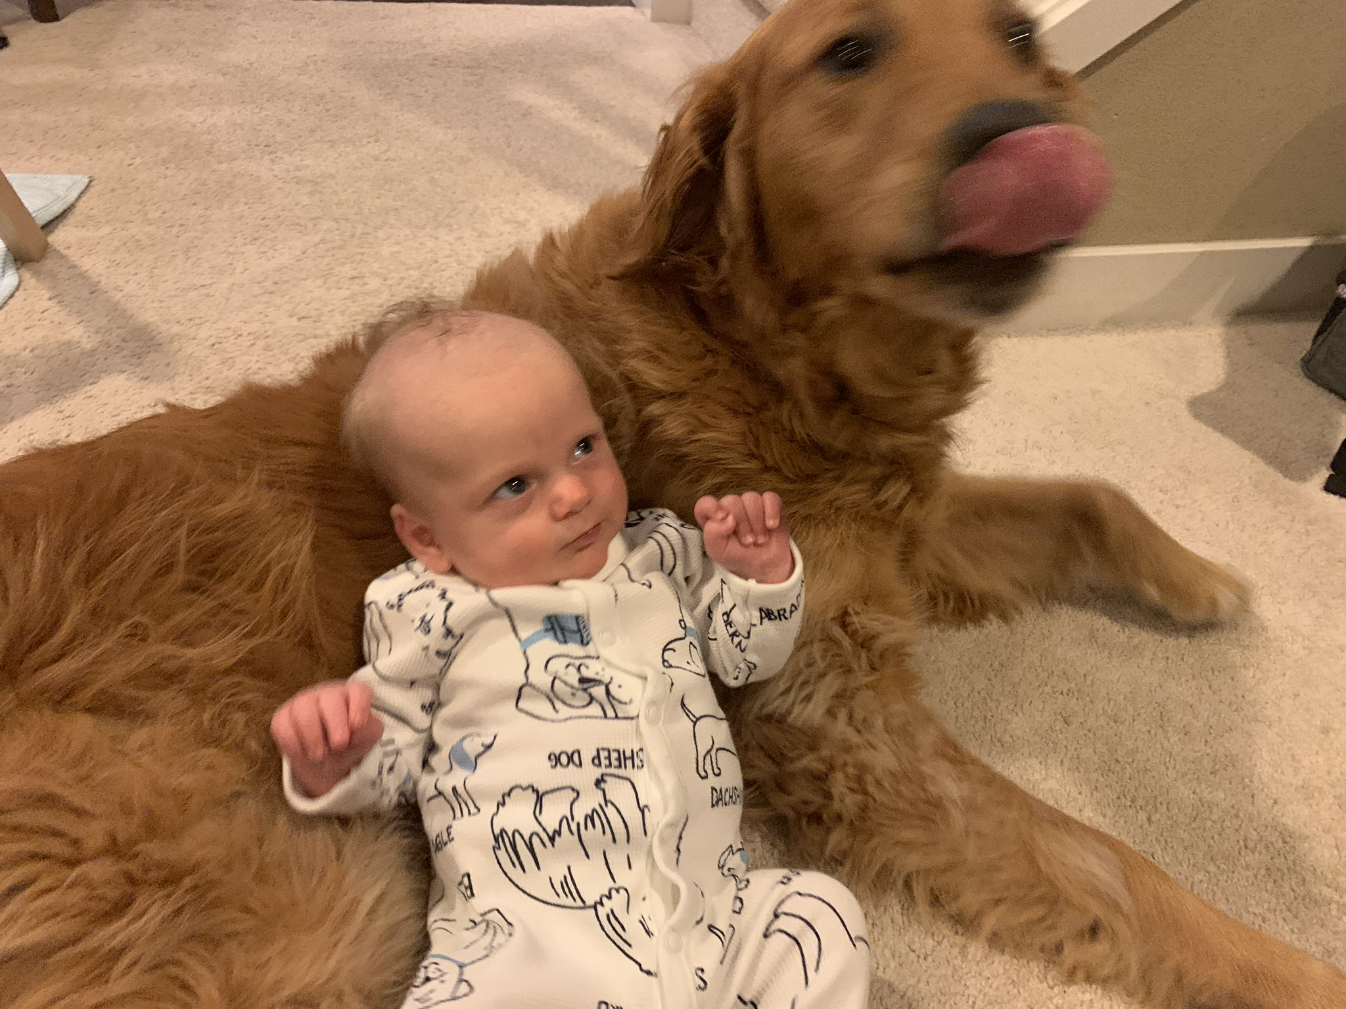
We know about family…
Notes:
Of course, we all want knowledge about our family.

Slide 4
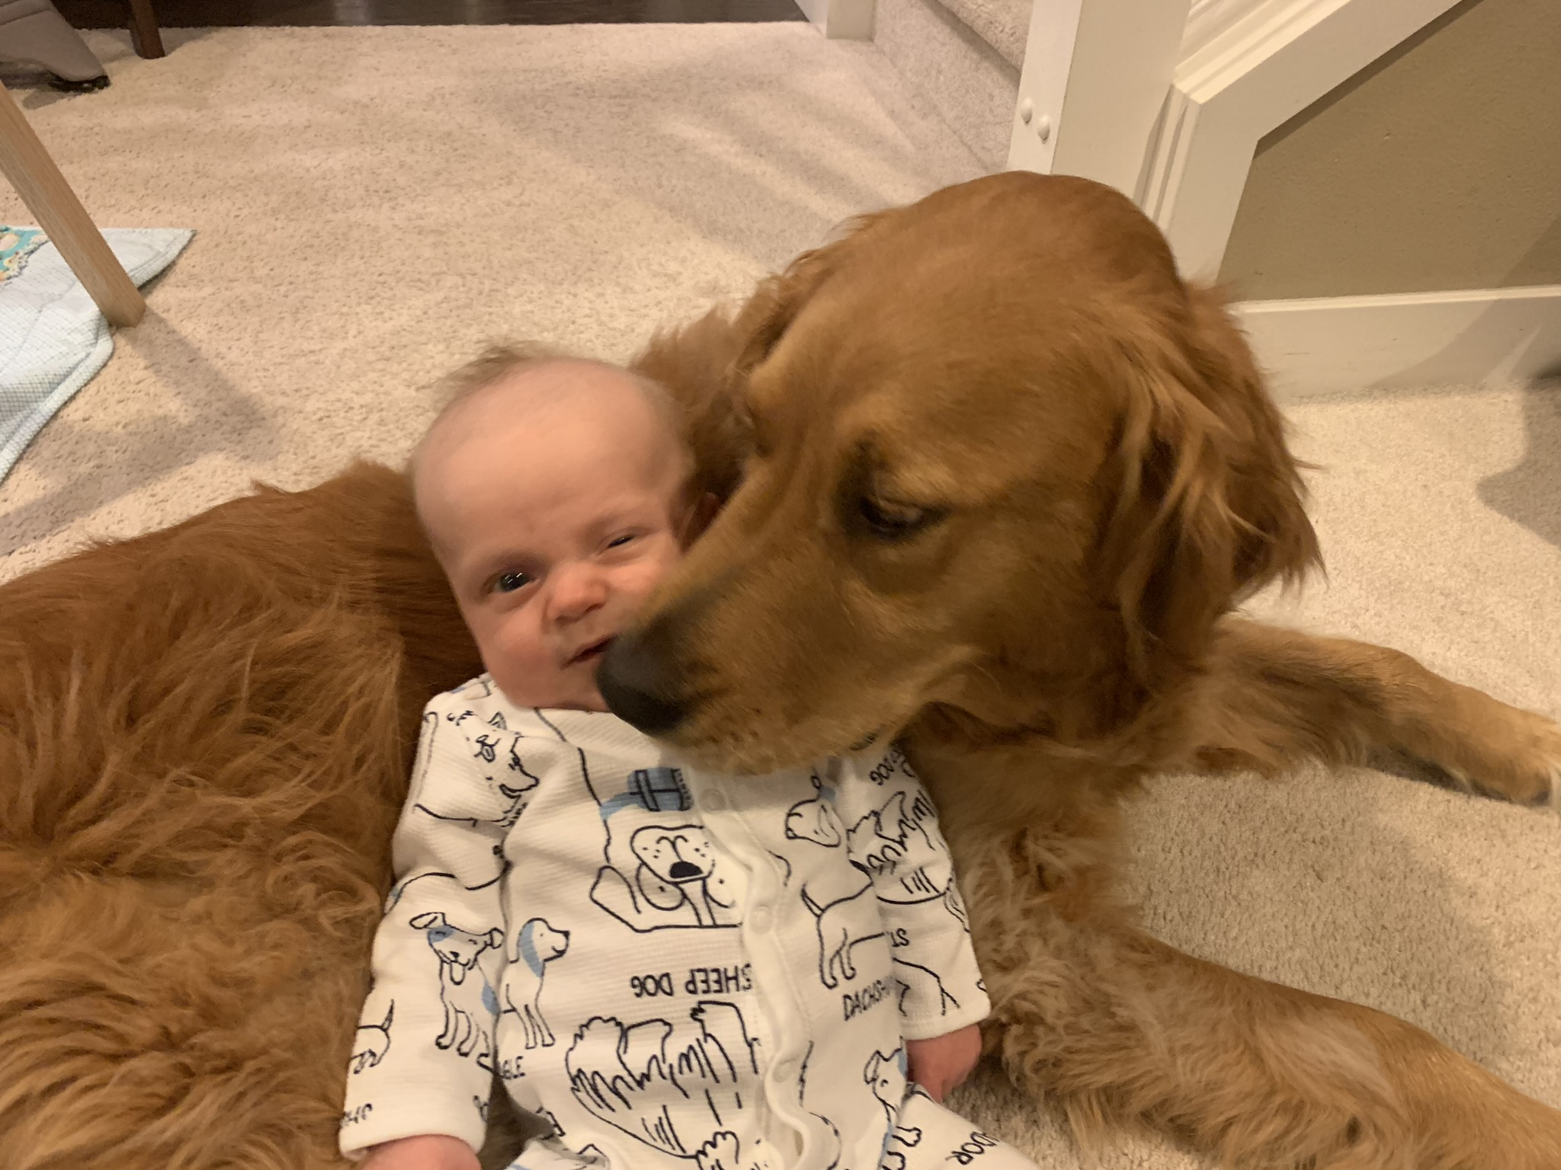
We know about family…
Notes:
I want to know how my grandson is getting along with the dog.

Slide 5
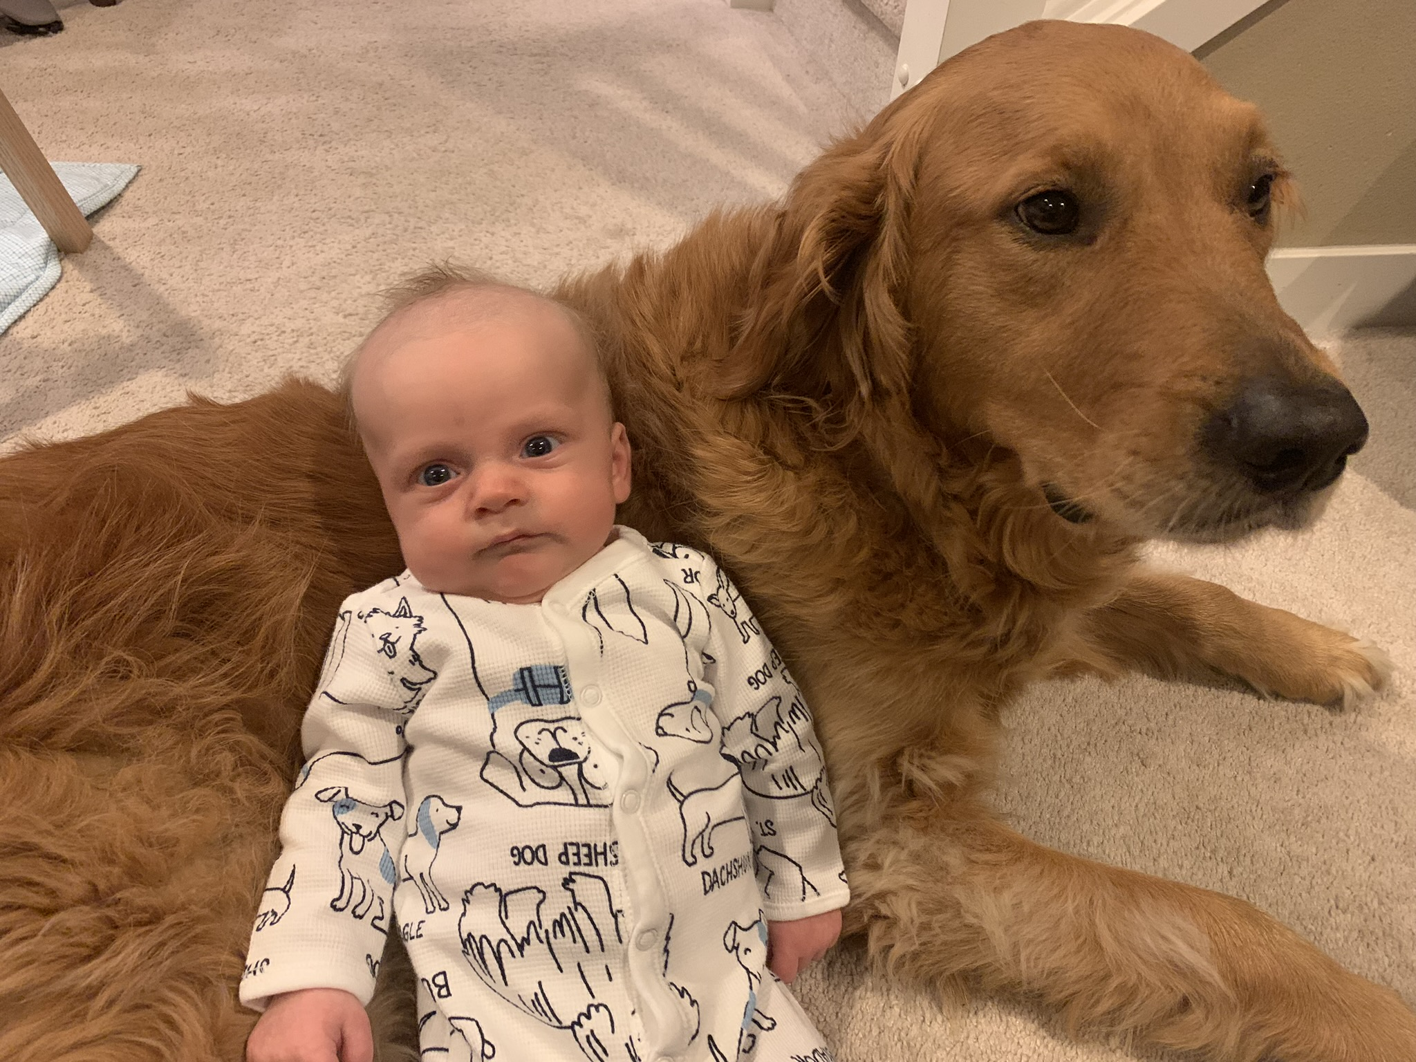
We know about family…
Notes:
Looks like he has some knowledge to gain about dog kisses!

Slide 6

It seems we know about…
all the wrong things…

Slide 7
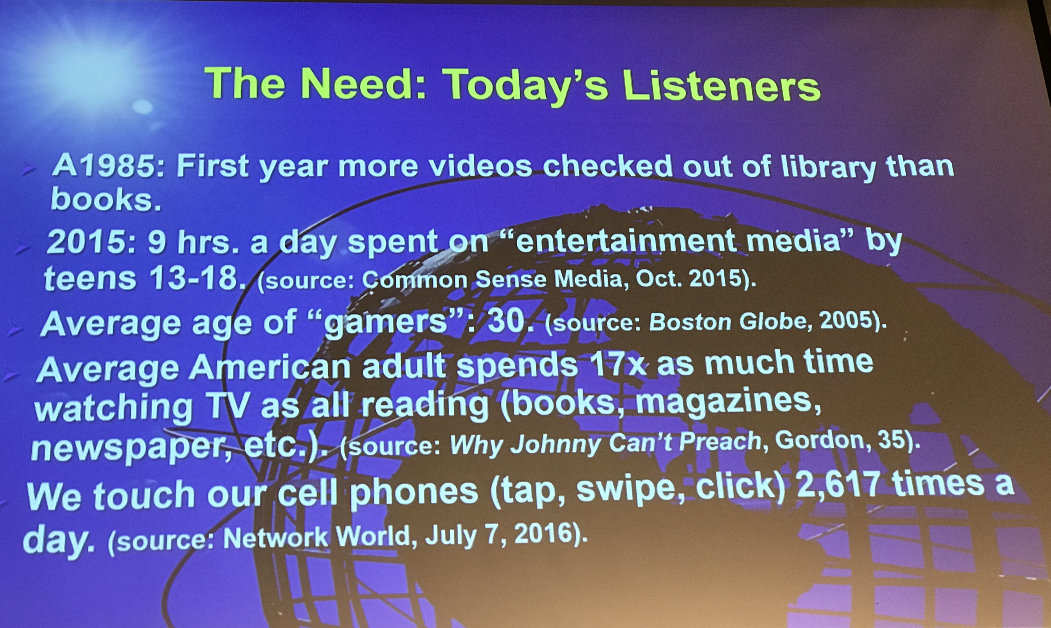
What We Know About…

Slide 8
Theme
23
Knowledge
to Combat False Teaching
2 Peter
Notes:
But the knowledge that Peter is talking about is knowledge to fight heresy…

Slide 9
Key Verse
284
“Therefore, dear friends, since you already know this, be on your guard so that you may not be carried away by the error of lawless men and fall from your secure position. But grow in the grace and knowledge of our Lord and Savior Jesus Christ. To him be glory both now and forever! Amen” (3:17-18).
2 Peter
Notes:
The last two verses of his letter notes twice the importance of knowing the truth.

Slide 10

Growing
In Faith
Notes:
You’ve likely heard much about growing in faith.

Slide 11


grow in
GRACE
Notes:
But Peter’s emphasis is on growing in grace. What does that mean?
______
To translate this slide, delete the picture and translate the text underneath it.

Slide 12

Grow in the Grace and Knowledge of our Lord Jesus Christ
Notes:
Even further, Peter says his letter tells us to grow in the grace and knowledge of the Lord Jesus Christ. Put that in your own words for your neighbor sitting next to you.

Slide 13
Key Verse
284
“Therefore, dear friends, since you already know this, be on your guard so that you may not be carried away by the error of lawless men and fall from your secure position. But grow in the grace and knowledge of our Lord and Savior Jesus Christ. To him be glory both now and forever! Amen” (3:17-18).
2 Peter
Notes:
So how do we do this? How do we grow in grace and knowledge? What do we need to know to do this?

Slide 14

What to know to grow…
Notes:
In short, what do we need to know to grow?

Slide 15

What must you know to grow in grace rather than to fall for false teaching?
2 Peter

Slide 16

Background to 2 Peter
Notes:
To answer this question, let’s see the context in which Peter wrote…

Slide 17

Let's Study Through Scripture
The Bible: Book by Book
Notes:
OP-01-Gen-06
OP-02-Lev-05
NP-2 Peter-18
OS-09-1Sam-34
OS-10-2Sam-48
OS-12-2Kings-94
OS-13-1Chron-41
OS-14-2Chron-63
We are in a study through the whole Bible right now, book by book. The goal is to give us a basic understanding of each book of the Bible.

Slide 18
NT Overview (Chronological)
38
124
39-41
"To the remotest part of the earth" (Acts 1:8)
Acts 9 13 14 15 16 18 21 27 28
Apr 48-
Sep 49
1
Galatia
Apr 50-
Sep 52
2
Aegean
Spr 53-
May 57
3
Asia
Feb 60-
Mar 62
1
Rome
Spr 62-
Fall 67
4
Spain
Aut 67-
Spr 68
2
Rome
Summer 35-
37
Damascus
Antioch
May 57-
Aug 59
Trials
Fall 49
The
Council
Spring 68
Expansion of Church
35 48 49 50 52 53 57 60 62 67 68 95
Matt
Luke
Acts
Mark
John
Gal
1 Thess
1 Cor
Eph
1 Tim
2 Tim
Jude
James
2 Thess
2 Cor
Col
Titus
Heb
1 John
Romans
Philem
1 Pet
2 John
Gospels & Acts
Phil
2 Pet
3 John
Pauline Epistles
1234
Journeys
Rev
General Epistles
Rome
Imprisonments
Chronological
Notes:
Peter’s second letter is only the third General Epistle in our NT. After this study, we have 10 more NT books until we finish this series that I am calling “The Bible: Book by Book.”

Slide 19
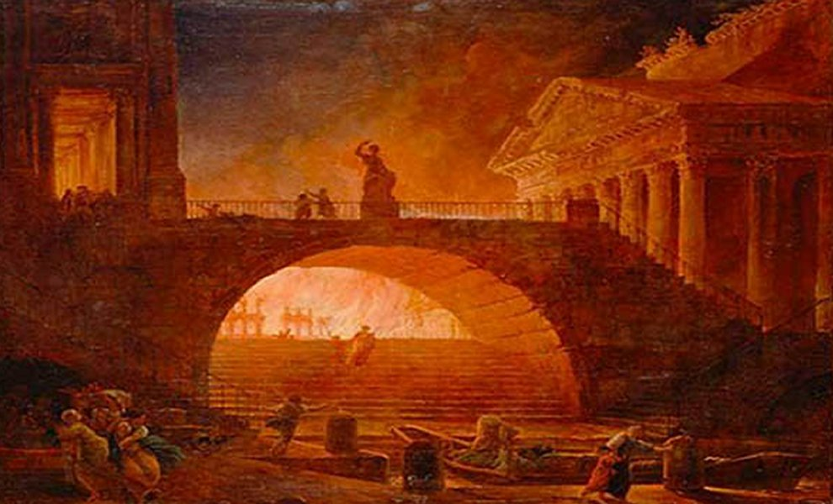
The Great Fire of Rome
July AD 64
Notes:
“On July 19, AD 64, a fire started in Rome. When the fire was extinguished six days later, more than 70% of the city was in ruins.”
____________
https://www.nationalgeographic.org/thisday/jul19/great-fire-rome/
“After six days the fire was brought under control, and before the damage could be measured, the fire reignited and burned for another three days. In the aftermath of the fire, two thirds of Rome had been destroyed.”
________
Great Fire of Rome
https://en.wikipedia.org/wiki/Great_Fire_of_Rome

Slide 20
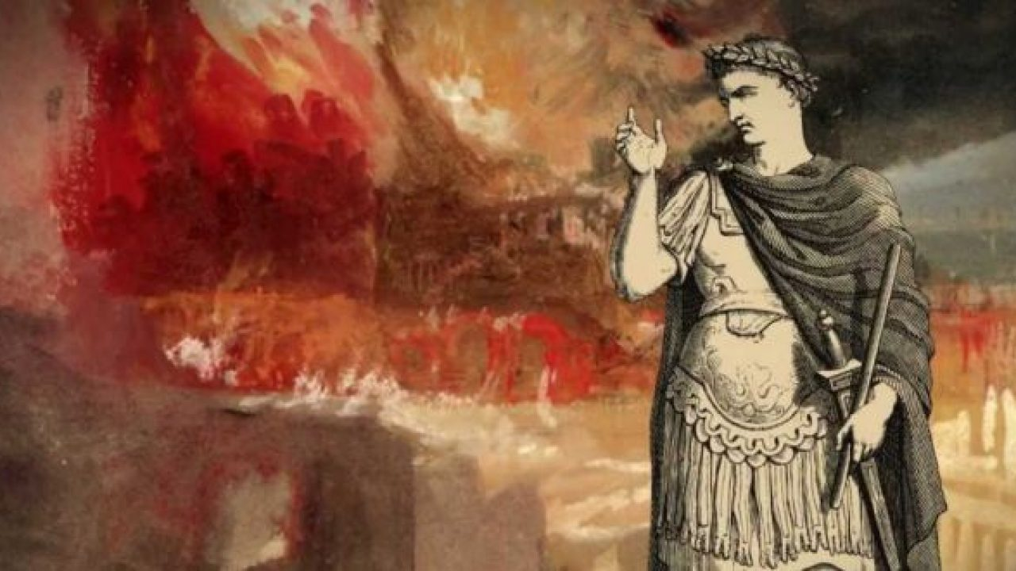
The Great Fire of Rome
July AD 64
Notes:
The “fire started in the enormous Circus Maximus stadium in Rome, now the capital of Italy. When the fire was finally extinguished six days later, 10 of Rome’s 14 districts were burned.
Ancient historians blamed Rome’s infamous emperor, Nero, for the fire. One historian said Nero was playing the fiddle while his city went up in flames [even though the fiddle wasn’t invented until another 1000 years later!]. Other historians say Nero wanted to raze the city so he could build a new palace.” This grand palace was planned to take 30% of the area of Rome!
_________
Jul 19, 64 CE: Great Fire of Rome
https://www.nationalgeographic.org/thisday/jul19/great-fire-rome/

Slide 21
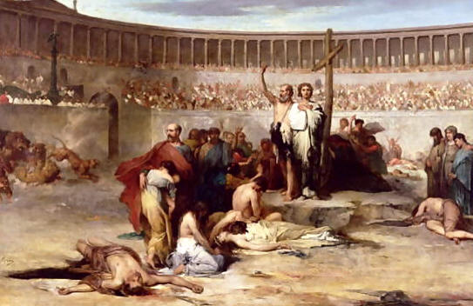
The Great Fire of Rome
July AD 64
Notes:
“Nero himself blamed [what he considered] a rebellious new cult—the Christians.
“Most modern historians don’t blame Nero for the Great Fire of Rome. Ancient Rome was a city of more than two million people, with thousands living in slums. These slums were filled with poorly constructed wooden apartment buildings. A fire in one apartment could quickly engulf the entire block.”
In any case, the fire made it very difficult to live as a Christian—especially in Rome. Christians were soon fed to lions and dogs and even used to light Nero’s evening gardens.
_________
Jul 19, 64 CE: Great Fire of Rome
https://www.nationalgeographic.org/thisday/jul19/great-fire-rome/

Slide 22
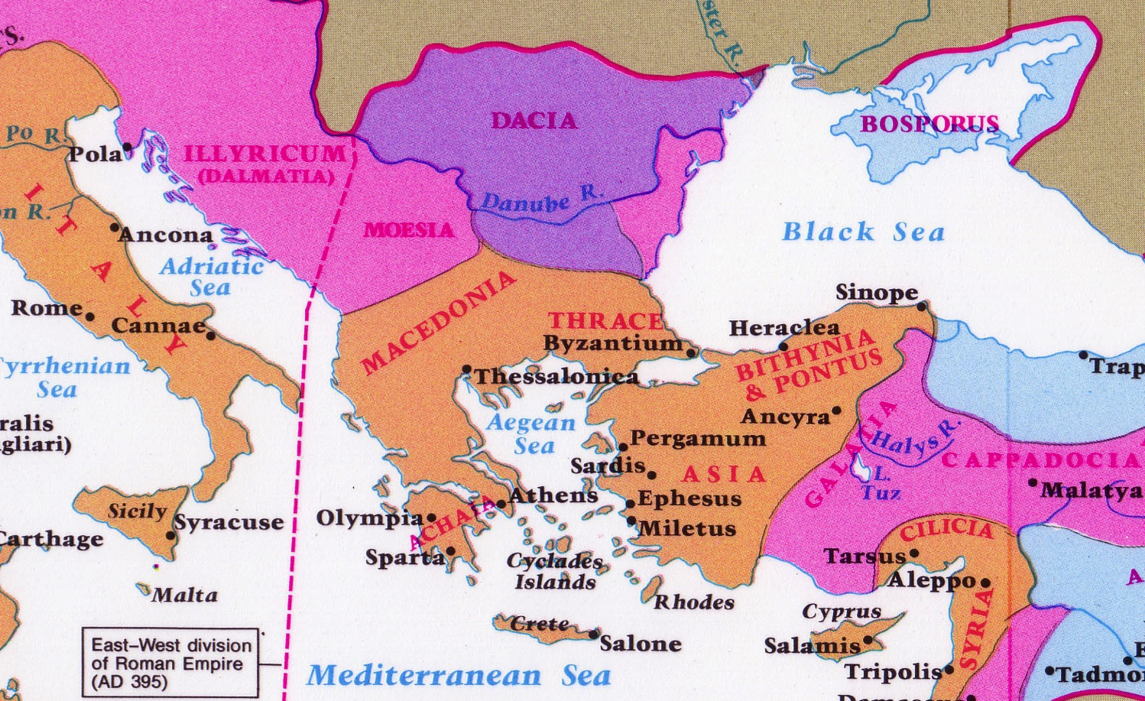
A Circular Letter from Peter to Turkey…
From
Rome
Notes:
Peter arrived in Rome about AD 62 and died there two years later in AD 64.

Slide 23
Contrast between 2 Letters
2 Peter
287
Contrasting Peter's Two Letters
First Peter
Second Peter
Nature of Problem
Persecution (Hostility)
False Teaching (Heresy)
Source of Problem
External
Internal
Theme
Hope
Knowledge
Key Word
(all forms)
"suffering"
(16 times)
"knowledge"
(16 times)
Date
Early
AD 64
Early spring
AD 64
Notes:
In AD 64, believers were falling away not due to persecution but due to lack of knowledge.
Peter had likely sent his first letter to the readers only months before.
In fact, more NT letters were written in the 60s than in any other decade. Why? Two reasons:
In 1 Peter, Peter advised believers to stand firm in God’s grace during unjust suffering—as this was the first big wave of suffering to hit the church.
More than that, though, was the proliferation of false teachers in the 60s.

Slide 24


Joshua Harris
Notes:
Perhaps you have heard of Joshua Harris. In 1997 at age 21 he wrote a significant book called I Kissed Dating Goodbye. It was a hit and God used it mightily to support the purity movement. He himself waited until marriage for sex and later wrote Boy Meets Girl.

Slide 25
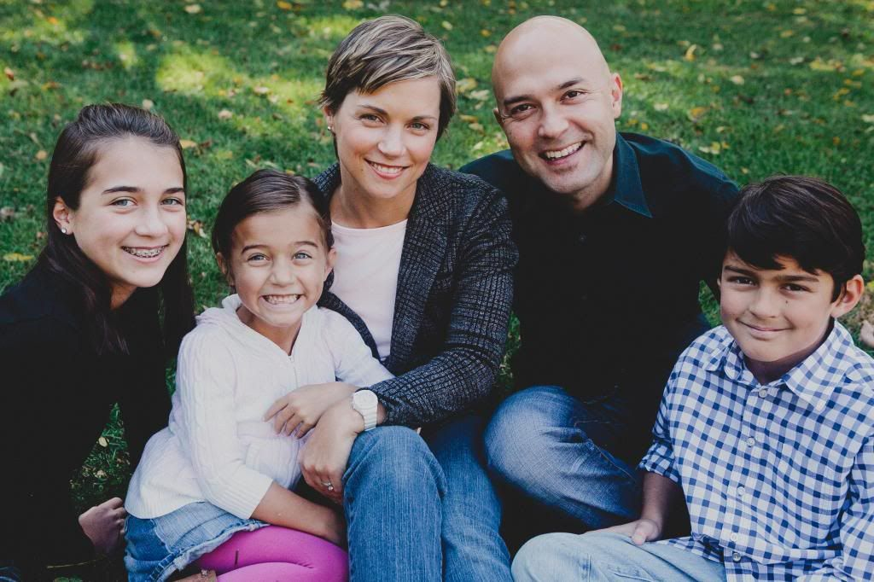
Joshua & Shannon Harris
Notes:
It happened in his own life when God gave him his wife Shannon and three great kids.

Slide 26
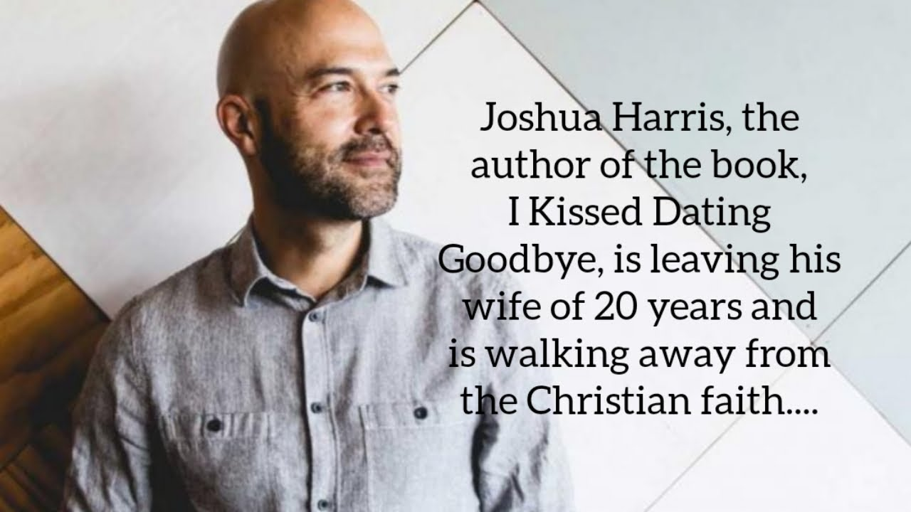
Apostasy of Joshua Harris
Notes:
Yet in July 2019, Harris announced the breakup of his marriage.

Slide 27
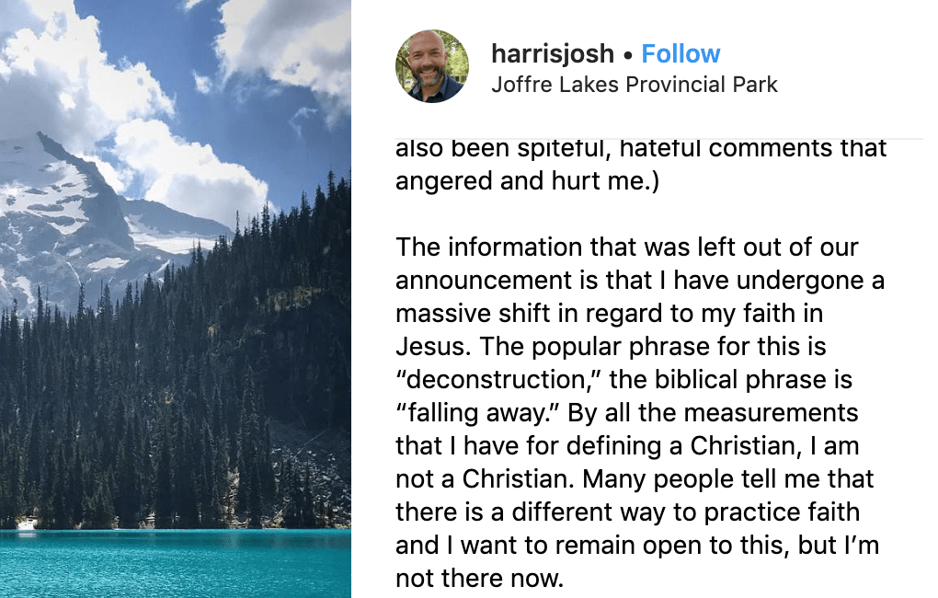
Apostasy of Joshua Harris
Notes:
He also claimed to be leaving his faith [read second paragraph above].

Slide 28
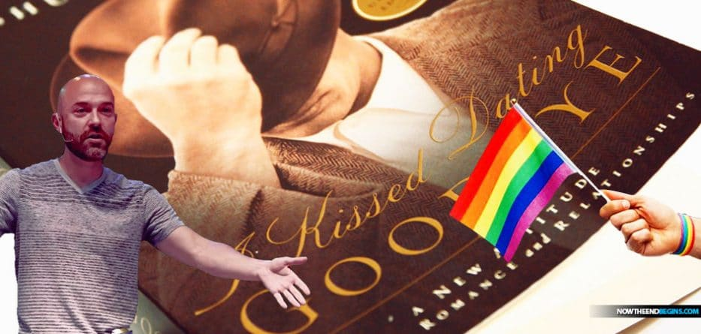
Apostasy of Joshua Harris
Notes:
He has now started waving the rainbow flag too. Sadder than that…

Slide 29
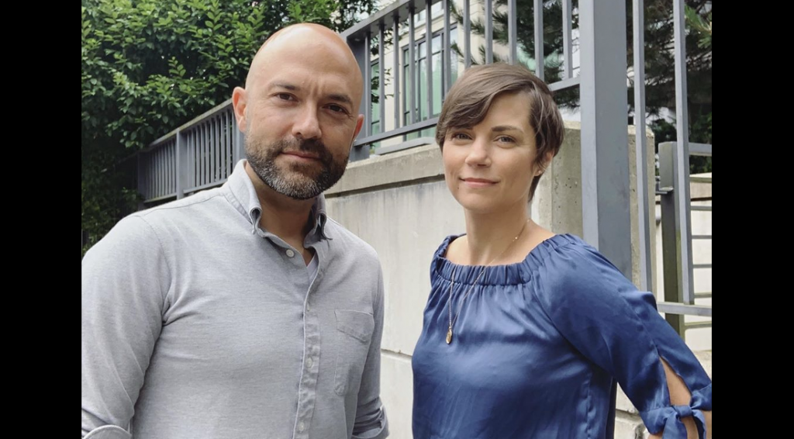
Apostasy of Joshua Harris
“The man who urged Christians to embrace ‘purity’ if they wanted a happy marriage is now ending his own”
—Friendly Atheist website
Notes:
The website “Friendly Atheist” notes, “The man who urged Christians to embrace ‘purity’ if they wanted a happy marriage is now ending his own.”
————
“In news that surely marks the end of an era, Joshua Harris has announced that he and his wife Shannon are separating.
Why is that noteworthy? Because Harris is the infamous author of I Kissed Dating Goodbye, the 1997 book that jumpstarted the “purity culture” movement among evangelical Christians. He got married to Shannon a few years after his book was released and wrote about the relationship in Boy Meets Girl: Say Hello to Courtship (2000).
The man who urged Christians to embrace “purity” if they wanted a happy marriage is now ending his own.
We’re not saying that with any delight or schadenfreude. The couple has three kids who will be affected by this, and what they’re all going through is entirely between them. We don’t know why they’re separating, and frankly, it shouldn’t matter.
But it’s still worth mentioning because Harris is best known for telling other people how to conduct their relationships.
His book, which came out when he was only 21, advised an entire generation of Christians to practice “courtship” instead of dating, the latter of which he saw as a “fast track” to divorce. Harris also advised against “emotional infidelity” — that is, falling in love with someone whom you don’t eventually marry.
His words were embraced by untold numbers of parents, youth pastors, and other church authority figures. Consequently, many people took his words as gospel, and ended up marrying the first person they ever had a crush on, at extremely young ages, with no prior relationship experience.
A few years ago, Harris went on an apology tour of sorts, saying he regretted wrecking so many people’s lives. Many of his former fans, however, found his apologies empty and insincere. While he said the book would no longer be printed (or reprinted), Harris didn’t really acknowledge that he was wrong in principle. He still rejected LGBTQ relationships. While he now said that dating might have its benefits even if it didn’t lead to marriage, he blamed people for how they followed his advice, not the crux of the advice itself.
And now the man who convinced countless Christians to jump into a marriage before ever truly knowing themselves will be single once again.
Tempting though it may be to gloat about this news, keep in mind that Harris was indoctrinated, too. While he is fully responsible for perpetuating toxic ideologies as an adult, he grew up in the same toxic purity culture that he encouraged with his readers. He likely didn’t know any better when he inadvertently became the father of a movement.
The news of his separation essentially confirms what we already knew: Purity culture makes extraordinary promises that it ultimately cannot keep.
The prevailing message of I Kissed Dating Goodbye was this: Follow these rules, and your marriage will be safe. Your relationship will be happier and more successful than those of your peers who dated around before settling down.
As it turns out, relationships are as complex as the people in them. Being abstinent doesn’t change that. Dating around doesn’t change that. There aren’t any foolproof “rules” after all.
It’s long past time for the “purity” advocates to update their guidebooks.”
““Purity Culture” Advocate Joshua Harris Announces Separation from Spouse
By Sarahbeth Caplin
July 18, 2019
https://friendlyatheist.patheos.com/2019/07/18/purity-culture-advocate-joshua-harris-announces-separation-from-spouse/

Slide 30

Three truths to know…
Notes:
Today we will see three things that we need to know to grow in grace rather than fall for false teaching.

Slide 31
Summary Chart
2 Peter
284
Knowledge to Combat False Teaching
God's Election
Future Apostasy
Lord's Return
Chapter 1
Chapter 2
Chapter 3
Saluta-tion
1:1-2
Provides Every Need
1:3-11
Foundation of Knowledge
1:12-21
False Teachers Coming
2:1-3a
End in Hell
2:3b-10a
Character Described
2:10b-22
Scoffers Before Rapture
3:1-7
Temporary World Motivates Holiness
3:8-16
Protection & Growth Encouraged
3:17-18
Adequacy of
Believers
Inadequacy of
Unbelievers
Expectancy of
Believers
Holiness
Heresy
Hope
Disciples
of the Lord
Diabolical Leaders
Day
of the Lord
Rome to North Asia Minor
AD 64

Slide 32
What must you know to grow in grace rather than to fall for false teaching?
2 Peter

Slide 33
I. Know that Christ chose and fully equipped you
(2 Peter 1).
What to know to grow…

Slide 34
Slides on
2 Peter 1

Slide 35

What do you really need to know?
Notes:
When you consider how many things there are to know, it can be daunting. You seminary students came to SBC to get answers to your questions, but now your list of questions has grown! So what are the essentials that we really need to know?
You've come to the right place, because Peter has an answer for you in today's text.

Slide 36
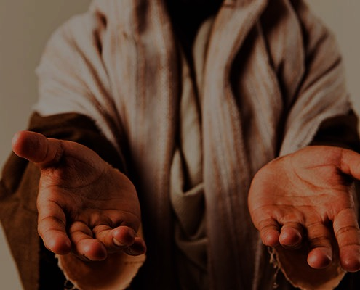
You are complete in Christ as God (2 Pet 1:1-4).
Notes:
God gives you all you need in your knowledge and faith in Jesus as deity.

Slide 37

"This letter is from Simon Peter, a slave and apostle of Jesus Christ. I am writing to you who share the same precious faith we have. This faith was given to you because of the justice and fairness of Jesus Christ, our God and Savior"
(2 Peter 1:1 NLT).
Notes:
Peter notes that his readers had the same faith as "ours" (1a).
There is a great sense of humility here where the great apostle puts himself on the same level as his meek readers.
In this pre-Gnostic world, teachers prided themselves with their privileged, so-called "secret knowledge."
Yet Peter says the righteousness provided by Jesus Christ gives us all the "same faith"! Wow!
The phrase "our God and Savior" also teaches Christ's deity (1b).
"The grammar here clearly indicates that 'God and Savior' are one Person, not two (i.e., there is one Gr. article with two substantives). This passage ranks with the great Christological passages of the New Testament which plainly teach that Jesus Christ is coequal in nature with God the Father" (Gangel, BKC, 2:863-64).
We need to understand that our faith is in Jesus as God, not just some teacher of knowledge.

Slide 38
"May God give you more and more grace and peace as you grow in your knowledge of God and Jesus our Lord"
(2 Peter 1:2 NLT).
Notes:
God shows us Christ's person for grace and peace (2).
The word for "knowledge" here implies an intimate, personal relationship.
We need to know that grace is in Christ (2a).
We need to know that Christ alone gives us peace (2b).

Slide 39
"By his divine power, God has given us everything we need for living a godly life. We have received all of this by coming to know him, the one who called us to himself by means of his marvelous glory and excellence" (2 Peter 1:3 NLT).
Notes:
God gives you Christ's power to live a godly life (3).
Too often we think that we're missing some great secret to godliness.
Peter says that we already have all we need!
If we already have everything we need for a godly life (3), then why does Peter wish his readers more grace and peace (2)?
Evidently we don't apply or access all that God has in store for us!

Slide 40
"And because of his glory and excellence, he has given us great and precious promises. These are the promises that enable you to share his divine nature and escape the world's corruption caused by human desires"
(2 Peter 1:4 NLT).
Notes:
God gives you Christ's promises to live a godly life (4).
What specific promises does God give to help us be like Christ (4)?

Slide 41

Five Promises
      We have all we need to live a godly life (3).
      We share "his divine nature" where we will eventually become like Christ (4b).
      We can escape any sin (4c).
      We are elected and promised salvation (10).
      If we're consistent in character (5-9), then we will be richly rewarded (10-11).

Slide 42


Grow step-by-step in Christ-likeness (5-7)

Slide 43
"In view of all this, make every effort to respond to God's promises. Supplement your faith with a generous provision of moral excellence, and moral excellence with knowledge" (2 Peter 1:5 NLT).

Slide 44
"and knowledge with self-control, and self-control with patient endurance, and patient endurance with godliness"
(2 Peter 1:6 NLT).

Slide 45
"and godliness with brotherly affection, and brotherly affection with love for everyone" (2 Peter 1:7 NLT).

Slide 46
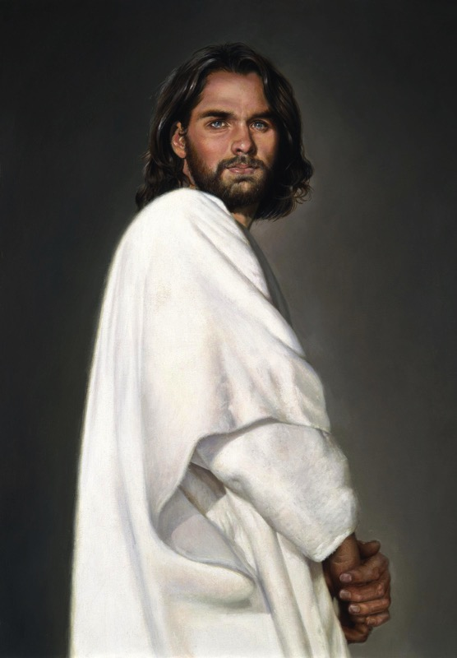
2 Peter 1
Effective & Productive Christian Life (1:5-7)
289
Pure & Christ-like ("participate in the divine nature," v. 4)
Love
Brotherly Kindness
Godliness
Perseverance
Self Control
Knowledge
Goodness
Faith
Notes:
Faith in Christ justifies us and starts our growth in character (5a).
Goodness (moral excellence) results from sins forgiven (5b).
Knowledge helps our goodness expand (5c).
Self-control comes from knowing Christ's own self-control (6a).
Perseverance is self-control over the long haul (6b).
Godliness results from persevering over the long haul (6c).
Brotherly kindness results since godliness is relational (7a).
Love is the climax as the highest character trait (7b).
These traits explain how we should show the divine nature in verse 4.

Slide 47

We don't always grow in Christ-likeness (1:8-9).

Slide 48
"The more you grow like this, the more productive and useful you will be in your knowledge of our Lord Jesus Christ"
(2 Peter 1:8 NLT).
Notes:
Some believers continue to grow and become more effective (8).

Slide 49
"But those who fail to develop in this way are shortsighted or blind, forgetting that they have been cleansed from their old sins" (2 Peter 1:9 NLT).
Notes:
Others stop character growth by forgetting they're forgiven (9).
In fact, most of the NT addresses believers who are not living up to God's standards. This is why God moved authors like Peter and Paul and James and others to write!

Slide 50
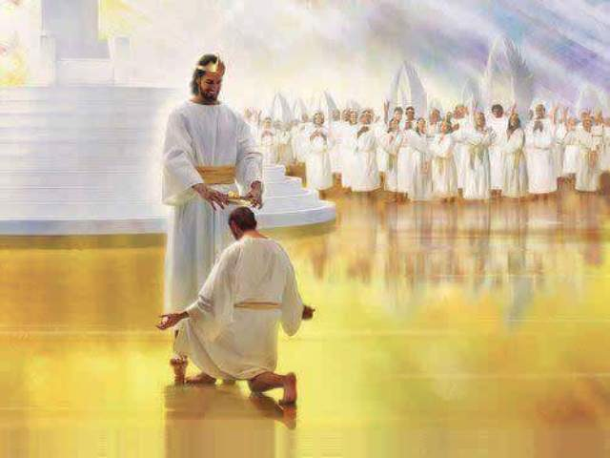
When we work hard, we'll be rewarded instead of falling away (1:10-11).

Slide 51
"So, dear brothers and sisters, work hard to prove that you really are among those God has called and chosen. Do these things, and you will never fall away" (2 Peter 1:10 NLT).
Notes:
When we work hard to show we're saved, we won't fall away (10).
Does "make your calling and election sure" (10) mean that we can add anything to Christ's work to be saved? No. It means we should live consistent with that salvation.
The NLT captures the idea well: "Work hard to prove that you really are among those God has called and chosen." When you seek to be more like Christ, you won't fall back. Instead…

Slide 52
"Then God will give you a grand entrance into the eternal Kingdom of our Lord and Savior Jesus Christ"
(2 Peter 1:11 NLT).
Notes:
God will reward us when we live consistent to our calling (11).
Does receiving "a rich welcome into the eternal kingdom…" refer to a person as being saved (11)?
No, this refers to being fully rewarded like the person in verse 8 who keeps growing in character.
It means you do not "fall" (10b) like the person in verse 9 who has forgotten about his forgiveness.

Slide 53
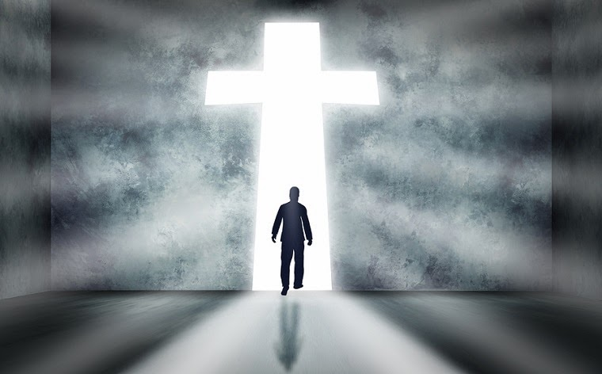
Main Idea of 2 Peter 1:1-11
Know you're complete in Christ to be more like Christ.
Notes:
Have your knowledge of Christ lead you to be Christ-like (restated MI).

Slide 54


Attacks Against Scripture Today
289b
What teaching do you hear today that seeks to undermine the truthfulness of our faith?
Presentation_ID
54
54
© 2003 Cisco Systems, Inc. All rights reserved.
54

Slide 55


How should we fight heresy?

Slide 56
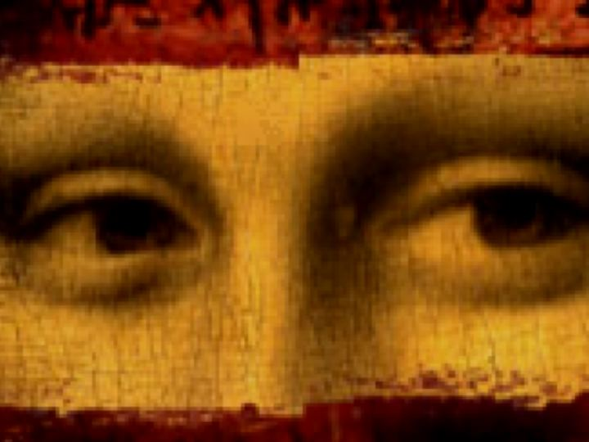
The Gospel of Brown
Jesus married Mary Magdalene
Their daughter grew up in France
His deity was invented in AD 325
We have the wrong NT Gospels
Christianity = the Divine Feminine
Christians cover up this conspiracy

Slide 57

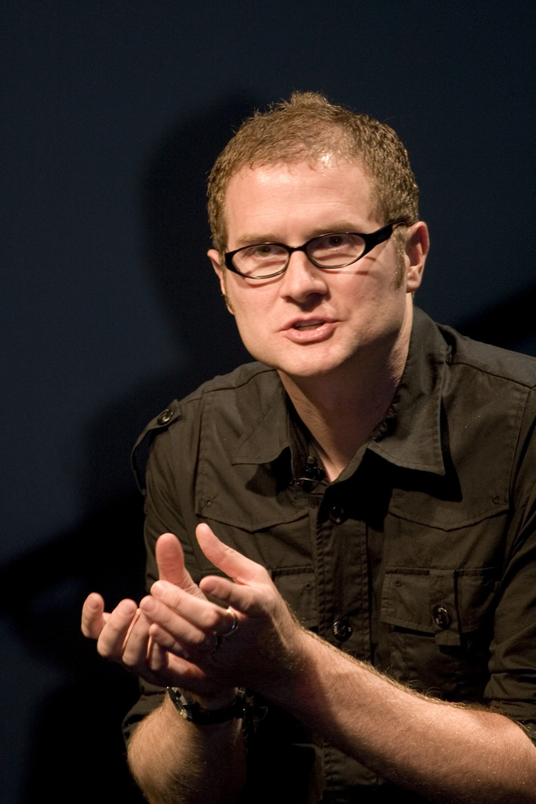
Rob Bell
Notes:
Another prominent pastor in the news in recent years is Pastor Rob Bell. Until 2011, he pastored Mars Hill Church in Michigan—one of the fastest growing churches in the USA. In 2011, Time named Bell on its list of the 100 Most Influential People in the World. That same year he wrote the book Love Wins: A Book About Heaven, Hell and the Fate of Every Person Who Ever Lived. What does he say about these things?
___________
“Rob Bell
From Wikipedia, the free encyclopedia
https://en.wikipedia.org/wiki/Rob_Bell accessed 10 Aug 2019
Jump to navigation Jump to search For other people with the same name, see Robert Bell (disambiguation).
Bell at the 2011 Time 100 gala
Robert Holmes "Rob" Bell Jr. (born August 23, 1970) is an American author, speaker and former pastor. Bell was the founder of Mars Hill Bible Church located in Grandville, Michigan, which he pastored until 2012. Under his leadership Mars Hill was one of the fastest-growing churches in America. He is also the author of the New York Times bestseller Love Wins and the writer and narrator of a series of spiritual short films called NOOMA. In 2011, Time named Bell on its list of the 100 Most Influential People in the World. He has since become a freelance writer and speaker appearing on various talk shows and national speaking tours on topics related to spirituality and leadership. He also hosts a popular podcast called,'The Robcast.' In 2018, a documentary about Bell called The Heretic was released.^{[1]}
Contents
1 Biography
1.1 Education and ministry
1.2 Mars Hill Bible Church
1.3 Other projects
1.4 Television
2 Beliefs
3 Publications
4 References
5 External links
Biography
Education and ministry
Bell is the son of U.S. District Judge Robert Holmes Bell, who was appointed to the federal bench by Ronald Reagan.^{[2][3]}
After graduating from high school, Bell attended Wheaton College in Illinois. While at Wheaton, he roomed with Ian Eskelin of All Star United. With friends Dave Houk, Brian Erickson, Steve Huber and Chris Fall, he formed the indie rock band, "_ton bundle", which was reminiscent of bands such as R.E.M. and Talking Heads. During this time _ton bundle wrote the song "Velvet Elvis", based upon the same Velvet Elvis painting that he used in his first book, Velvet Elvis: Repainting the Christian Faith. Wheaton College was also where Bell met his wife, Kristen. The band _ton bundle started to gain some local fame and was even asked to perform at large events, but when Bell was struck with viral meningitis^{[4]} these plans fell through.^{[5]}
Bell received his bachelor's degree in 1992 from Wheaton and taught water skiing in the summers at the college's Honey Rock Camp, making about thirty dollars a week. During this time, he offered to teach a Christian message to the camp counselors after no pastor could be found. He taught a message about rest and was later approached by several people, each of them telling him that he should pursue teaching as a career.
Bell moved to Pasadena, California to pursue this calling for teaching and received a M.Div. from Fuller Theological Seminary. According to Bell, he never received good grades in preaching class because he always tried innovative ways to communicate his ideas. During his time at Fuller he was a youth intern at Lake Avenue Church. He did, however, occasionally attend Christian Assembly in Eagle Rock, California, which led to him and his wife asking questions in the direction of how a new style of church would appear.
Between 1995 and 1997, Bell formed a band called Big Fil which released two CDs; the first was a self-titled disc and the second was titled Via De La Shekel. When asked what style of music they played, Bell would respond with "Northern Gospel!", which later became the name of a song on the second album. Even after Big Fil stopped performing, Bell continued with two more projects by the name of Uno Dos Tres Communications volume 1 and 2, both of which had a similar musical sound to Big Fil.
Mars Hill Bible Church
Bell and his wife moved from California to Grand Rapids to be close to family and on invitation to study under pastor Ed Dobson. He handled many of the preaching duties for the Saturday Night service at Calvary Church. Bell announced that he would be branching out on his own to start a new kind of community and he would call it "Mars Hill" after the Greek site where the apostle Paul told a group, "For as I walked around and looked carefully at your objects of worship, I even found an altar with this inscription: TO AN UNKNOWN GOD. Now what you worship as something unknown I am going to proclaim to you."^{[6]}
In February 1999, Bell founded Mars Hill Bible Church, with the church originally meeting in a school gym in Wyoming, Michigan. Within a year the church was given a shopping mall in Grandville, Michigan, and purchased the surrounding land. In July 2000 the 3,500 "grey chair" facility opened its doors. As of 2005, an estimated 11,000 people attended the two "gatherings" on Sundays at 9 and 11 AM.^{[7][full citation needed]} As of March 2011, Sunday attendance numbered between 8,000 and 10,000.^{[8]} His teachings at Mars Hill inspired the popular "Love Wins" bumper sticker, and the congregation freely distributed these stickers after services.^{[9]}
In order to maintain balance in his life, Bell maintained his Fridays as a personal sabbath, where he did not allow contact by electronic means, and had all pastoral duties transferred to other Mars Hill pastors.^{[10]}
In the January 2007 issue of the magazine TheChurchReport.com, Bell was named No. 10 in its list of "The 50 Most Influential Christians in America" as chosen by their readers and online visitors.^{[11]}
In June 2011, Bell was named by Time Magazine as one of the "2011 Time 100", the magazine's annual list of the 100 most influential people in the world.^{[12]}
Bell stepped down from the church he founded on September 22, 2011 in order to pursue other areas to reach a broader audience.^{[13][14]} He later said that his book Love Wins had led to a fallout with the congregation and forced him on a "search for a more forgiving faith."^{[15]}
In July 2012 Bell held his first major event since leaving Mars Hill, speaking at the famous Viper Room night club in Los Angeles.^{[16]} Bell hosts conferences and workshops in Laguna Beach for "leaders, teachers, preachers, entrepreneurs, artists, pastors—anyone whose work involves creating something and then turning it loose in the world."^{[17]}
Other projects
Bell is the featured speaker in NOOMA – a series of short films. The title of the video series, "NOOMA", is an English variation of the Greek word pneuma which means breath or spirit. All the videos feature the teachings of Bell accompanied by music written and sung by local independent artists with the exception of The Album Leaf's music being licensed for the NOOMA DVD Lump.
In August 2005, Zondervan Publishing published Bell's first book, Velvet Elvis: Repainting the Christian Faith. Velvet Elvis is, according to the official online summary, "for the millions of people who are fascinated by Jesus, but can’t do the standard Christian package. In his debut book, Bell explores a new understanding of the Christian faith."^{[18]}
Bell's Everything is Spiritual national speaking tour launched on June 30, 2006, in Chicago, drawing sold-out crowds in cities across North America. The proceeds from ticket sales were used to support WaterAid, an international non-profit organization dedicated to helping people escape the poverty and disease caused by living without safe water and sanitation.
Bell's second book, titled Sex God: Exploring the Endless Connections between Sexuality and Spirituality, was released in March 2007. In February and March 2007 Bell hosted a "Sex God" tour on six university campuses to promote his book. The tour functioned more as a time for engaging questions and conversation. Questions ranged from Old Testament codes to homosexuality to what should Christians do with the word "evangelical". Each night ended with the showing of NOOMA number 15 entitled "YOU".^{[citation needed]}
In June 2007 Bell toured the United Kingdom and Ireland with a series called Calling All Peacemakers.^{[19]}
Bell launched another speaking tour on November 5, 2007, in Chicago. "The Gods Aren't Angry" again drew sold-out crowds in cities across North America. The subject matter was a narrative defense of justification through faith and not works (sacrifice). Proceeds from this tour were used to support the Turame Microfinance program supporting the poor in Burundi, a mission supported by Bell's church.
Bell's 2009 project, Drops Like Stars, explores the links between creativity and suffering. Drops Like Stars was an international tour and a book, initially handwritten by Bell, with photographs. The title of the project comes from a young child's view of raindrops on a window at night. Rather than focusing on the conundrum of why an all-powerful God would allow suffering, Bell instead looks at the creativity, empathy, new connections, and growth that can spring from suffering. When asked in an interview how he had become interested in suffering, Bell replied that as a pastor he had been given a front row seat in the most poignant moments of people's lives. At the same time he was doing lectures on creativity and realized, "There was a connection between these two halves of my life – all these connections between suffering and art-making."^{[20]}
In September 2013 Bell was interviewed by Oprah for her Super Soul Sunday television show. Bell's book, What We Talk About When We Talk About God, was also listed as the first recommended book that month in Oprah's "Book of the Month" club.^{[21]}
Television
ABC television announced production of a new television drama, Stronger, co-written by Bell and Carlton Cuse, the executive producer of the television series, Lost.^{[22]} The show, based loosely on Bell's life and his unpublished novel-turned-pilot-script, would follow the life of Tom Stronger, a musician on a spiritual journey.^{[23]} Ultimately, Bell and Cuse were unable to get approval to shoot a pilot for Stronger.
Bell and Cuse have moved on to another project described as a "faith-inflected talk show" presented by Bell. Two tapings of the proposed show were filmed in September 2012 in a warehouse in Los Angeles' art district in order to put together a reel for network executives.^{[24]} At the time, they were referenced as either That One Show Rob Bell and Carlton Cuse Have Been Working On, or The September Shows for short.^{[25][26][27]} A trailer has since been produced using The Rob Bell Show as a title card. His first and second guest each night were Cathleen Falsani and James "Jame-o" Primbram, an eco-warrior.
Beliefs
In his writings, Bell says "I affirm the truth anywhere in any religious system, in any worldview. If it's true, it belongs to God."^{[28]}
Bell says, "This is not just the same old message with new methods. We're rediscovering Christianity as an Eastern religion, as a way of life. Legal metaphors for faith don't deliver a way of life. We grew up in churches where people knew the nine verses why we don't speak in tongues, but had never experienced the overwhelming presence of God."^{[9]}
Bell's book Love Wins caused a major controversy within the evangelical community. The controversy was the subject of a Time magazine cover story and a featured article in the New York Times.^{[29][30][31]} In the book, Bell states that "It's been clearly communicated to many that this belief (in hell as eternal, conscious torment) is a central truth of the Christian faith and to reject it is, in essence, to reject Jesus. This is misguided and toxic and ultimately subverts the contagious spread of Jesus' message of love, peace, forgiveness and joy that our world desperately needs to hear." In this book, Bell outlines a number of views of hell, including universal reconciliation. Though he does not choose any one view as his own, he states "Whatever objections a person may have of [the universalist view], and there are many, one has to admit that it is fitting, proper, and Christian to long for it."
The book was criticized by numerous conservative evangelical figures (in particular, some reformed church leaders), such as Albert Mohler, John Piper, and David Platt, with Mohler saying that the book was "theologically disastrous" for not rejecting universalism.^{[32][33]} Other evangelicals, such as Brian McLaren,^{[34][35]} Greg Boyd^{[36]} and Eugene Peterson^{[37][38][39]} defended Bell's views. Bell denies that he is a universalist and says that he does not embrace any particular view but argues that Christians should leave room for uncertainty on the matter. As Jon Meacham stated, Love Wins presents [Bell's] "case for living with mystery rather than demanding certitude."^{[40][41]} Some evangelicals argued that this "uncertainty" is incompatible with Scripture,^{[42]} while others say that the book is simply promoting overdue conversation about some traditional interpretations of Scripture.^{[43][44]} In the book, Bell also questions "evacuation theology" which has Christians focused on getting to heaven, instead of focusing on God's renewal and transformation of this world. Bell argues that Jesus (and the wider Jewish tradition of which he was a part) focused on God's ongoing restoration of this world, not getting individuals to heaven.^{[45][46]}
At his Viper Room appearance in July 2012, Bell took a question from an audience member concerned about the church's acceptance of gay members. Said Bell, "Some people are gay, and you're our brothers and you're our sisters, and we love you. We love you... [Gay people] are passionate disciples of Jesus just like I'm trying to be, so let's all get together and try to do something about the truly big problems in our world."^{[47]} On March 17, 2013, in an interview at Grace Cathedral in San Francisco, Bell said, "I am for marriage. I am for fidelity. I am for love, whether it's a man and a woman, a woman and a woman, a man and a man...And I think the ship has sailed. This is the world we are living in and we need to affirm people wherever they are."^{[48]}
In March 2013, Bell expressed frustration with the state of conservative evangelicalism, calling it "a very narrow, politically intertwined, culturally ghettoized Evangelical subculture." He says that Evangelicals have "turned away lots of people" from the church by talking about God in ways that "don't actually shape people into more loving, compassionate people," adding that Evangelicals "have supported policies and ways of viewing the world that are actually destructive, and we've done it in the name of God and we need to repent."^{[48]}
Publications
Velvet Elvis: Repainting the Christian Faith (Zondervan, 2005) ISBN 0-310-26345-X
Sex God: Exploring the Endless Connections between Sexuality and Spirituality (Zondervan, 2007) ISBN 0-310-26346-8
Everything is Spiritual (DVD) (Zondervan, 2007) ISBN 0-310-28556-9
The Gods Aren't Angry (DVD) (Flannel, 2008) ISBN 0-310-29074-0
Jesus Wants to Save Christians: A Manifesto for the Church in Exile (Zondervan, 2008) ISBN 0-310-27502-4
Drops Like Stars: A Few Thoughts on Creativity and Suffering (Zondervan, 2009) ISBN 0-310-32704-0
Love Wins (Harper One, 2011) ISBN 978-0-06-204964-3
What We Talk About When We Talk About God (HarperOne 2013) ISBN 978-0062049667
The Zimzum of Love: A New Way of Understanding Marriage co-written with Kristen Bell (HarperOne 2014) ISBN 978-0062194244
How to be Here (Harper Collins 2016) ISBN 978-0007591329
NOOMA Videos
What Is the Bible? (HarperOne 2017) ISBN 978-0062194268

Slide 58
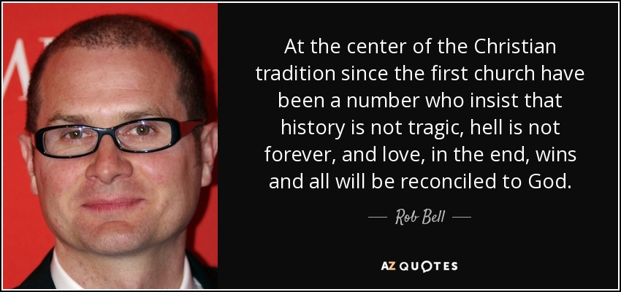
Rob Bell Universalism
At the center of the Christian tradition since the first church have been a number who insist that history is not tragic, hell is not forever, and love, in the end, wins and all will be reconciled to God.
—Rob Bell—
Notes:
He says that he is not a universalist, but he writes…
__________
“In the book, Bell states that "It's been clearly communicated to many that this belief (in hell as eternal, conscious torment) is a central truth of the Christian faith and to reject it is, in essence, to reject Jesus. This is misguided and toxic and ultimately subverts the contagious spread of Jesus' message of love, peace, forgiveness and joy that our world desperately needs to hear." In this book, Bell outlines a number of views of hell, including universal reconciliation. Though he does not choose any one view as his own, he states "Whatever objections a person may have of [the universalist view], and there are many, one has to admit that it is fitting, proper, and Christian to long for it."
_______
From Wikipedia, the free encyclopedia
https://en.wikipedia.org/wiki/Rob_Bell accessed 10 Aug 2019

Slide 59
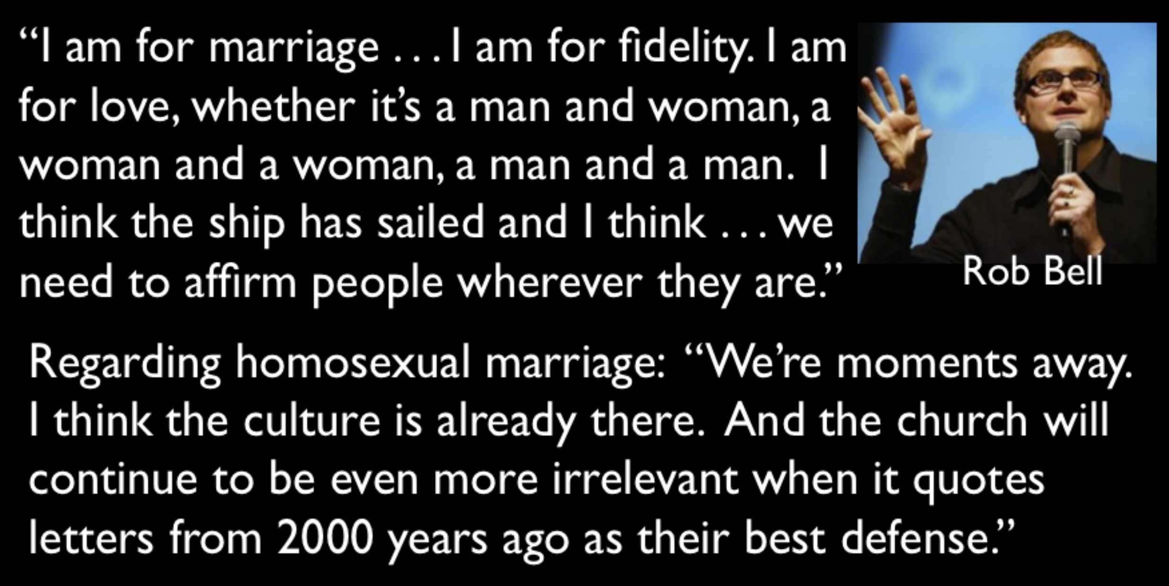
Apostasy of Rob Bell
“I am for marriage… I am for fidelity. I am for love, whether it’s a man and woman, a woman and a woman, a man and a man. I think the ship has sailed and I think… we need to affirm people wherever they are.”
Regarding homosexual marriage: “We’re moments away. I think the culture is already there. And the church will continue to be even more irrelevant when it quotes letters from 2000 years ago as their best defense.”
Notes:
Along with this nowadays seems to go the apology for what God says about homosexuality.

Slide 60
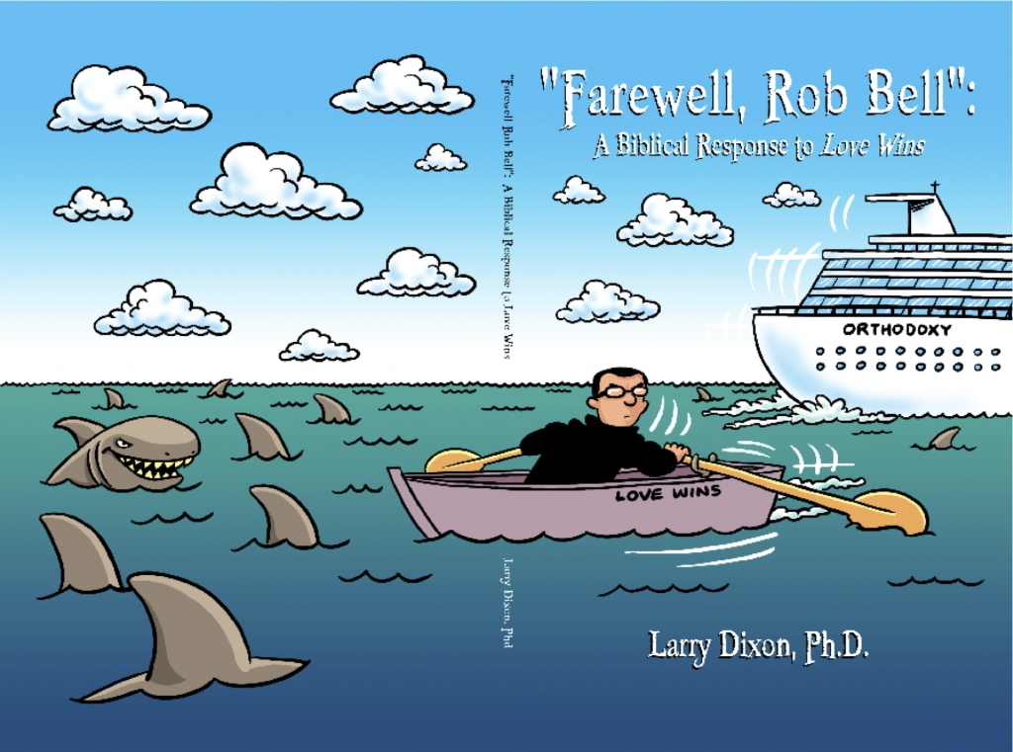
Rob Bell
Notes:
Bell, of course, has his critics who argue from the Bible that he has abandoned the faith. He left his church in 2011 but has new friends in Oprah Winfrey and other apostates like Joel Osteen.

Slide 61

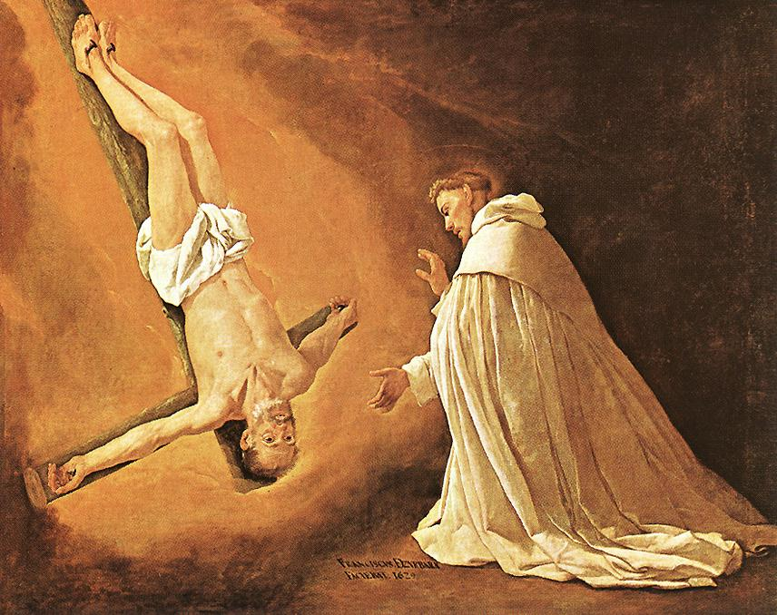
"For our Lord Jesus Christ has shown me that I must soon leave this earthly life, ¹⁵so I will work hard to make sure you always remember these things after I am gone" ( 2 Pet. 1:14-15 NLT)
Church tradition says Peter requested to be crucified upside down
61
61
61

Slide 62

What is Prophecy?
289b
"knowing this first of all, that no prophecy of Scripture comes from someone's own interpretation. For no prophecy was ever produced by the will of man, but men spoke from God as they were carried along by the Holy Spirit"
2 Peter 1:20-21 (ESV)

Slide 63
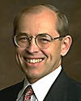
Wayne Grudem on Prophecy
Prophecy is…
"telling something that God has spontaneously brought to mind"
("Why Christians Can Still Prophesy: Scripture Encourages Us to Seek this Gift Yet Today," Christianity Today [September 16, 1988], 29)
Professor of NT
Phoenix Theological Seminary

Slide 64
What must you know to grow in grace rather than to fall for false teaching?
2 Peter

Slide 65
I. Know that Christ chose and fully equipped you
(2 Peter 1).
II. Know a fake teacher before you see one
(2 Peter 2).
What to know to grow…

Slide 66
Summary Chart
Knowledge to Combat False Teaching
2 Peter
284
God's Election
Future Apostasy
Lord's Return
Chapter 1
Chapter 2
Chapter 3
Saluta-tion
1:1-2
Provides Every Need
1:3-11
Foundation of Knowledge
1:12-21
False Teachers Coming
2:1-3a
End in Hell
2:3b-10a
Character Described
2:10b-22
Scoffers Before Rapture
3:1-7
Temporary World Motivates Holiness
3:8-16
Protection & Growth Encouraged
3:17-18
Adequacy of
Believers
Inadequacy of
Unbelievers
Expectancy of
Believers
Holiness
Heresy
Hope
Disciples
of the Lord
Diabolical Leaders
Day
of the Lord
Rome to North Asia Minor
AD 64

Slide 67
Slides on
2 Peter 2

Slide 68
Major Theme
288
KNOWLEDGE…
• for spiritual growth (2 Pet. 1)
• to combat heresy (2 Pet. 2)
• to sustain hope (2 Pet. 3)
2 Peter

Slide 69
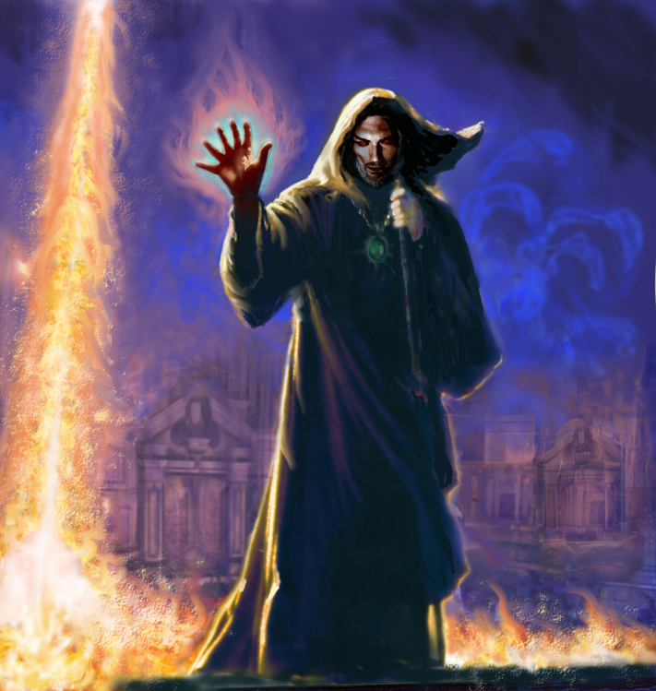
"But there were also false prophets in Israel, just as there will be false teachers among you. They will cleverly teach destructive heresies and even deny the Master who bought them. In this way, they will bring sudden destruction on themselves"
(2 Peter 2:1 NLT).
57

Slide 70

A. (2:1-3a)
What are the Characteristics of False Teachers?
2 Peter 2
Infiltration/secrecy (1a)
Destructive heresies (1b)
Deny Christ as Lord (1c)
Self-destructive (1d)
Many followers (2a)
Shameful ways (2b)
Discredit Christianity (2c)
Greed (3a)
Exploitive (3b)
Condemned (3c)

Slide 71

B. (2:3b-10a)
Hell for the Apostates
Protection for the Righteous
2 Peter 2
The destiny of all apostates in hell shows that believers will be protected as much as apostates will be condemned.

Slide 72

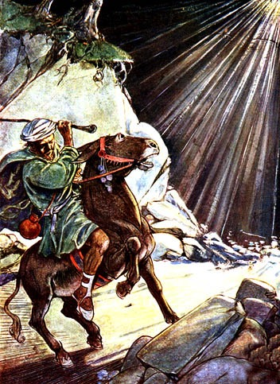
Balaam
354
Balaam Numbers 22–24

Slide 73
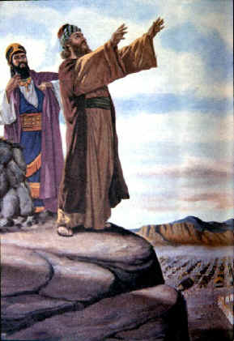
The Balaam Narrative
354
Balak fails to turn God against Israel–blessing by Balaam (Num. 22–24)
Beitzel, Moody Atlas, 1st ed., 94

Slide 74
2 Peter 2:15-16 (NIV)
354
They have left the straight way and wandered off to follow the way of Balaam son of Beor, who loved the wages of wickedness. But he was rebuked for his wrongdoing by a donkey–a beast without speech–who spoke with a man's voice and restrained the prophet's madness.

Slide 75

The Agony of Deceit

Slide 76
What must you know to grow in grace rather than to fall for false teaching?
2 Peter

Slide 77
I. Know that Christ chose and fully equipped you
(2 Peter 1).
II. Know a fake teacher before you see one
(2 Peter 2).
III. Know to live for the eternal—not the temporal
(2 Peter 3).
What to know to grow…

Slide 78
Summary Chart
Knowledge to Combat False Teaching
2 Peter
284
God's Election
Future Apostasy
Lord's Return
Chapter 1
Chapter 2
Chapter 3
Saluta-tion
1:1-2
Provides Every Need
1:3-11
Foundation of Knowledge
1:12-21
False Teachers Coming
2:1-3a
End in Hell
2:3b-10a
Character Described
2:10b-22
Scoffers Before Rapture
3:1-7
Temporary World Motivates Holiness
3:8-16
Protection & Growth Encouraged
3:17-18
Adequacy of
Believers
Inadequacy of
Unbelievers
Expectancy of
Believers
Holiness
Heresy
Hope
Disciples
of the Lord
Diabolical Leaders
Day
of the Lord
Rome to North Asia Minor
AD 64

Slide 79
Slides on
2 Peter 3

Slide 80
Skeptics Mock
Three Key Truths
290b
"…in the last days scoffers will come, mocking the truth and following their own desires. ⁴They will say, 'What happened to the promise that Jesus is coming again?'"
(2 Pet. 3:3b-4a NLT).
Christ's Return
Presentation_ID
80
80
© 2003 Cisco Systems, Inc. All rights reserved.
80

Slide 81
Skeptics Mock
Three Key Truths
290b
"'From before the times of our ancestors, everything has remained the same since the world was first created.' They deliberately forget that God made the heavens by the word of his command, and he brought the earth out from the water and surrounded it with water" (2 Pet. 3:4b-5 NLT).
Christ's Return
Creation
Presentation_ID
81
81
© 2003 Cisco Systems, Inc. All rights reserved.
81

Slide 82
Skeptics Mock
Three Key Truths
290b
"Then he used the water to destroy the ancient world with a mighty flood"
(2 Pet. 3:6 NLT).
Christ's Return
Global Flood
Creation
Presentation_ID
82
82
© 2003 Cisco Systems, Inc. All rights reserved.
82

Slide 83
Skeptics Mock
Three Key Truths
290b
Christ's Return
Global Flood
Creation
Presentation_ID
83
83
© 2003 Cisco Systems, Inc. All rights reserved.
83

Slide 84


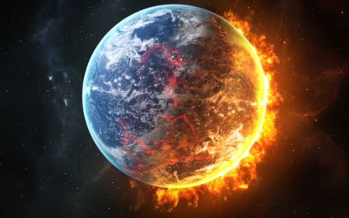
How will the Universe end?
Evolution
Bible
Notes:
Big Bang: heat death (cold, dark universe) or big crunch (collapsing universe)? OR…
Bible: literal heat death and then new heavens and new earth?

Slide 85
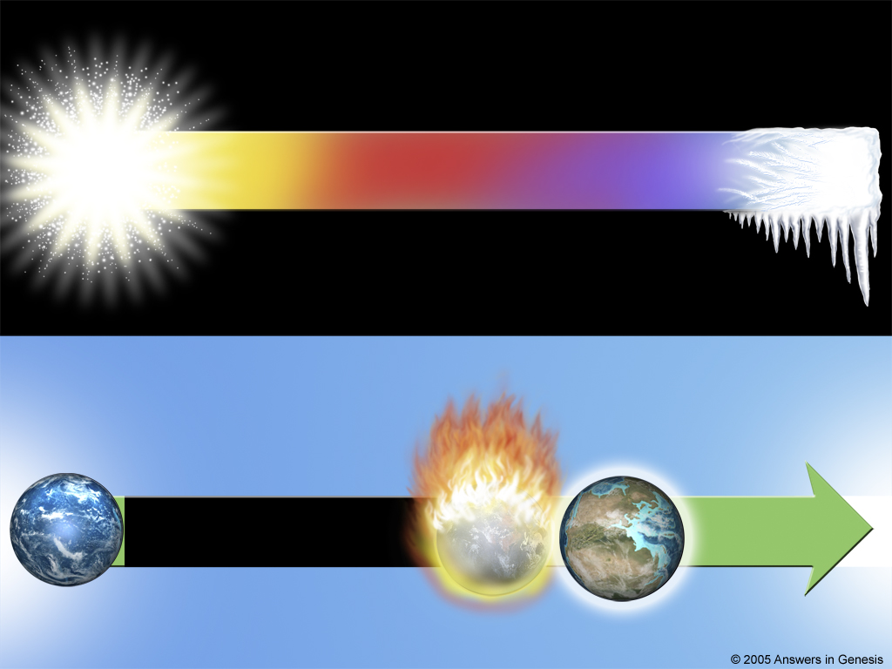
Big Bang Time line
Big Bang Future of the Universe
BIG BANG
Billions of Years
Heat Death
Big Bang Time line
Biblical Future of the Universe
Heat Destruction
6-Day
New
Heavens
Thousands of Years
Eternity
Creation
& Earth
Sin and Death
Genesis
2 Peter 3
Revelation
Notes:
The secular worldview sees the world starting with heat and cooling off into obscurity in the death of heat that takes billions of years.
The biblical teaching shows God’s truth—that the world started with temperate climate but will end with intense heat (2 Pet 3:10) before the Lord remakes it to last forever.

Slide 86
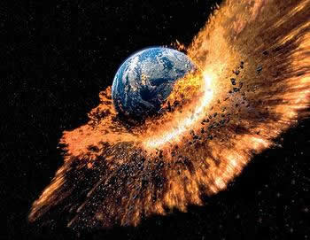
How does the Bible say it will end?
"But the day of the Lord will come as unexpectedly as a thief. Then the heavens will pass away with a terrible noise, and the very elements themselves will disappear in fire, and the earth and everything on it will be found to deserve judgment"
(2 Pet. 3:10 NLT)

Slide 87
How to live in light of the end?
"Since everything around us is going to be destroyed like this, what holy and godly lives you should live, ¹²looking forward to the day of God and hurrying it along. On that day, he will set the heavens on fire, and the elements will melt away in the flames" (2 Pet. 3:11-12 NLT)

Slide 88
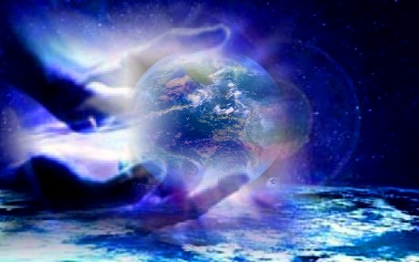
How to live in light of the end?
"But we are looking forward to the new heavens and new earth he has promised, a world filled with God's righteousness"
(2 Pet. 3:13 NLT)

Slide 89
Key Verse
284
“Therefore, dear friends, since you already know this, be on your guard so that you may not be carried away by the error of lawless men and fall from your secure position. But grow in the grace and knowledge of our Lord and Savior Jesus Christ. To him be glory both now and forever! Amen” (2 Peter 3:17-18).
2 Peter

Slide 90
What must you know to grow in grace rather than to fall for false teaching?
2 Peter

Slide 91
Main Idea
Know that Christ chose you and will judge apostates at his return.
2 Peter

Slide 92
I. Know that Christ chose and fully equipped you
(2 Peter 1).
II. Know a fake teacher before you see one
(2 Peter 2).
III. Know to live for the eternal—not the temporal
(2 Peter 3).
What to know to grow…

Slide 93

Synthesis
2 Peter
Synthesis
288
Know these things to combat heresy
1 God's election
2 Traits of apostasy
3 Lord's return

Slide 94
For Life Change:
Which teachers in your experience must you warn yourself and your family about? How?

Slide 95

Is God’s Word shaping you to grow in the grace and the knowledge of Christ?

Slide 96
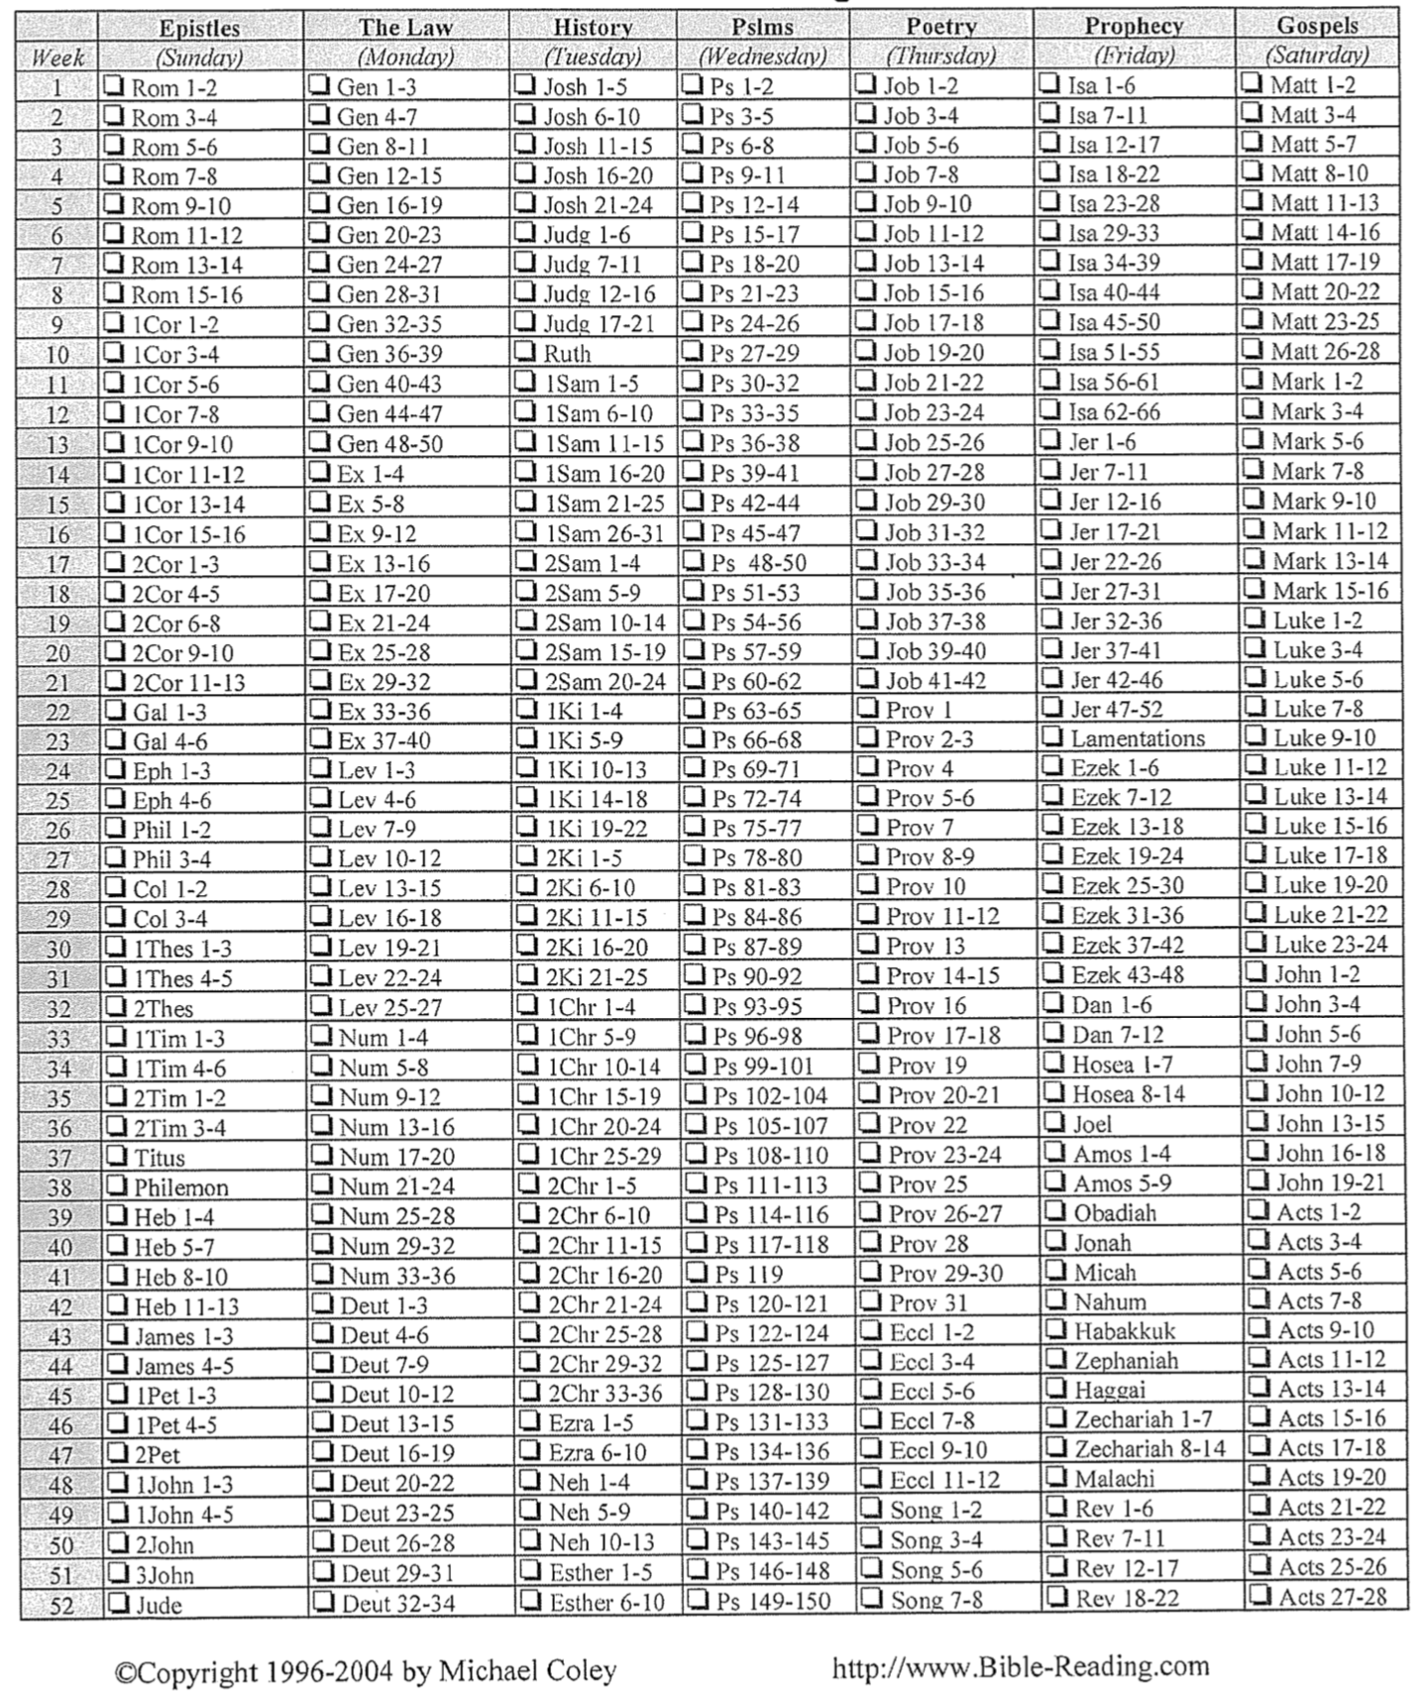
Bible Reading Plan
289h

Slide 97

Know Jesus, Know Peace

Slide 98
Black

Slide 99


NT Preaching • BibleStudyDownloads.org
Get this presentation and script for free!

